Slide 1
Welcome to My Presentation

Slide 2
Presentation To :
Name : Md. Imran Hossain
Assistant professor
Department of ICT
Comilla University
Presentation By :
Name : Nurul Afsar
ID : 11809051
Department of ICT
Comilla University

Slide 3
Analog Communication
Horizontal Scanning
Vertical Scanning

Slide 4
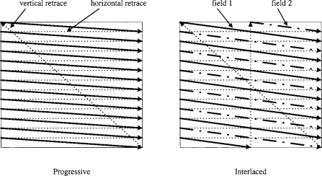
What Is Scanning ?
Scanning is the process carried out in a television system in order to obtain continuous frames and provides motion of picture. The scene is scanned both in the horizontal and vertical directions simultaneously in a rabid rate.
This is the continuous motion of the beam one from left to right across the screen and other from top to bottom their by covering the entire area of the picture. The down figure show path of the scanning beam total picture frame covered due to scanning process
The speed of scanning spot is very high trace about 625 lines in 1/25 sec is completed in one frame . So , in 1 sec 25 frames are scanned

Slide 5
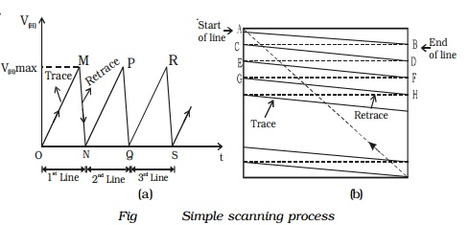
Types of Scanning
Horizontal Scanning
Vertical Scanning
One complete frame of a Tv picture is scanned 30 times per second . The electron is directed to move by deflection coil, which are located around the neck of the picture tube. The information applied to the deflection coils is in the form of a sawtooth wave , generated by the horizontal oscillator by the number of lines(525) to be scanned and the scanning rate.
Here , Show the figure of the Beam Scanning :

Slide 6
Horizontal Scanning
Horizontal scanning is the type of scanning spot moves from left hand corner of screen to the right hand corner of screen with a uniform speed due sawtooth current applied in the horizontal magnetic deflection coil.
The figure show the sawtooth current for horizontal scanning :
Total Time : 52ms + 12ms
= 64ms
trace
Retrace
R 52ms
12ms

Slide 7
Vertical Scanning
Vertical scanning is the type of scanning spot moves from top to bottam of the screen of with a uniform speed due to sawtooth current applied in the vertical deflection coil.
The figure shows the sawtooth current for vertical scanning :
Total Time : 18720micros + 1280micros
= 20000micros
trace
Retrace
= 20ms
R 18720ms
1280ms

Slide 8
Thanks

